Slide 1


Performance Tools Update
Dan Burkland
Professional Services Consultant
Tech ONTAP Live – 2016-01-13 & 2016-01-14
Notes:
Start off with an intro about your background

Slide 2
Agenda
Current State
New Performance Monitoring Solution
Deployment
Examples
Review
Resources

Slide 3

State of the Union: Performance Tools
OnCommand Performance Manager (OPM)
Free yet powerful performance monitoring application
Deployed using OVA or via RPM
cDOT only
Root cause analysis along with a suggested action plan
Current version – 2.0
OnCommand Insight (OCI)
Complete storage resource management solution
Inventory discovery
Capacity & performance monitoring
Detailed root cause analysis and bottleneck detection
Compliance
Supports multiple storage vendors
Current Version – 7.1.2
Notes:
Summarize OPM & OCI, contrast the two
Explain experiences and where OPM comes up short

Slide 4
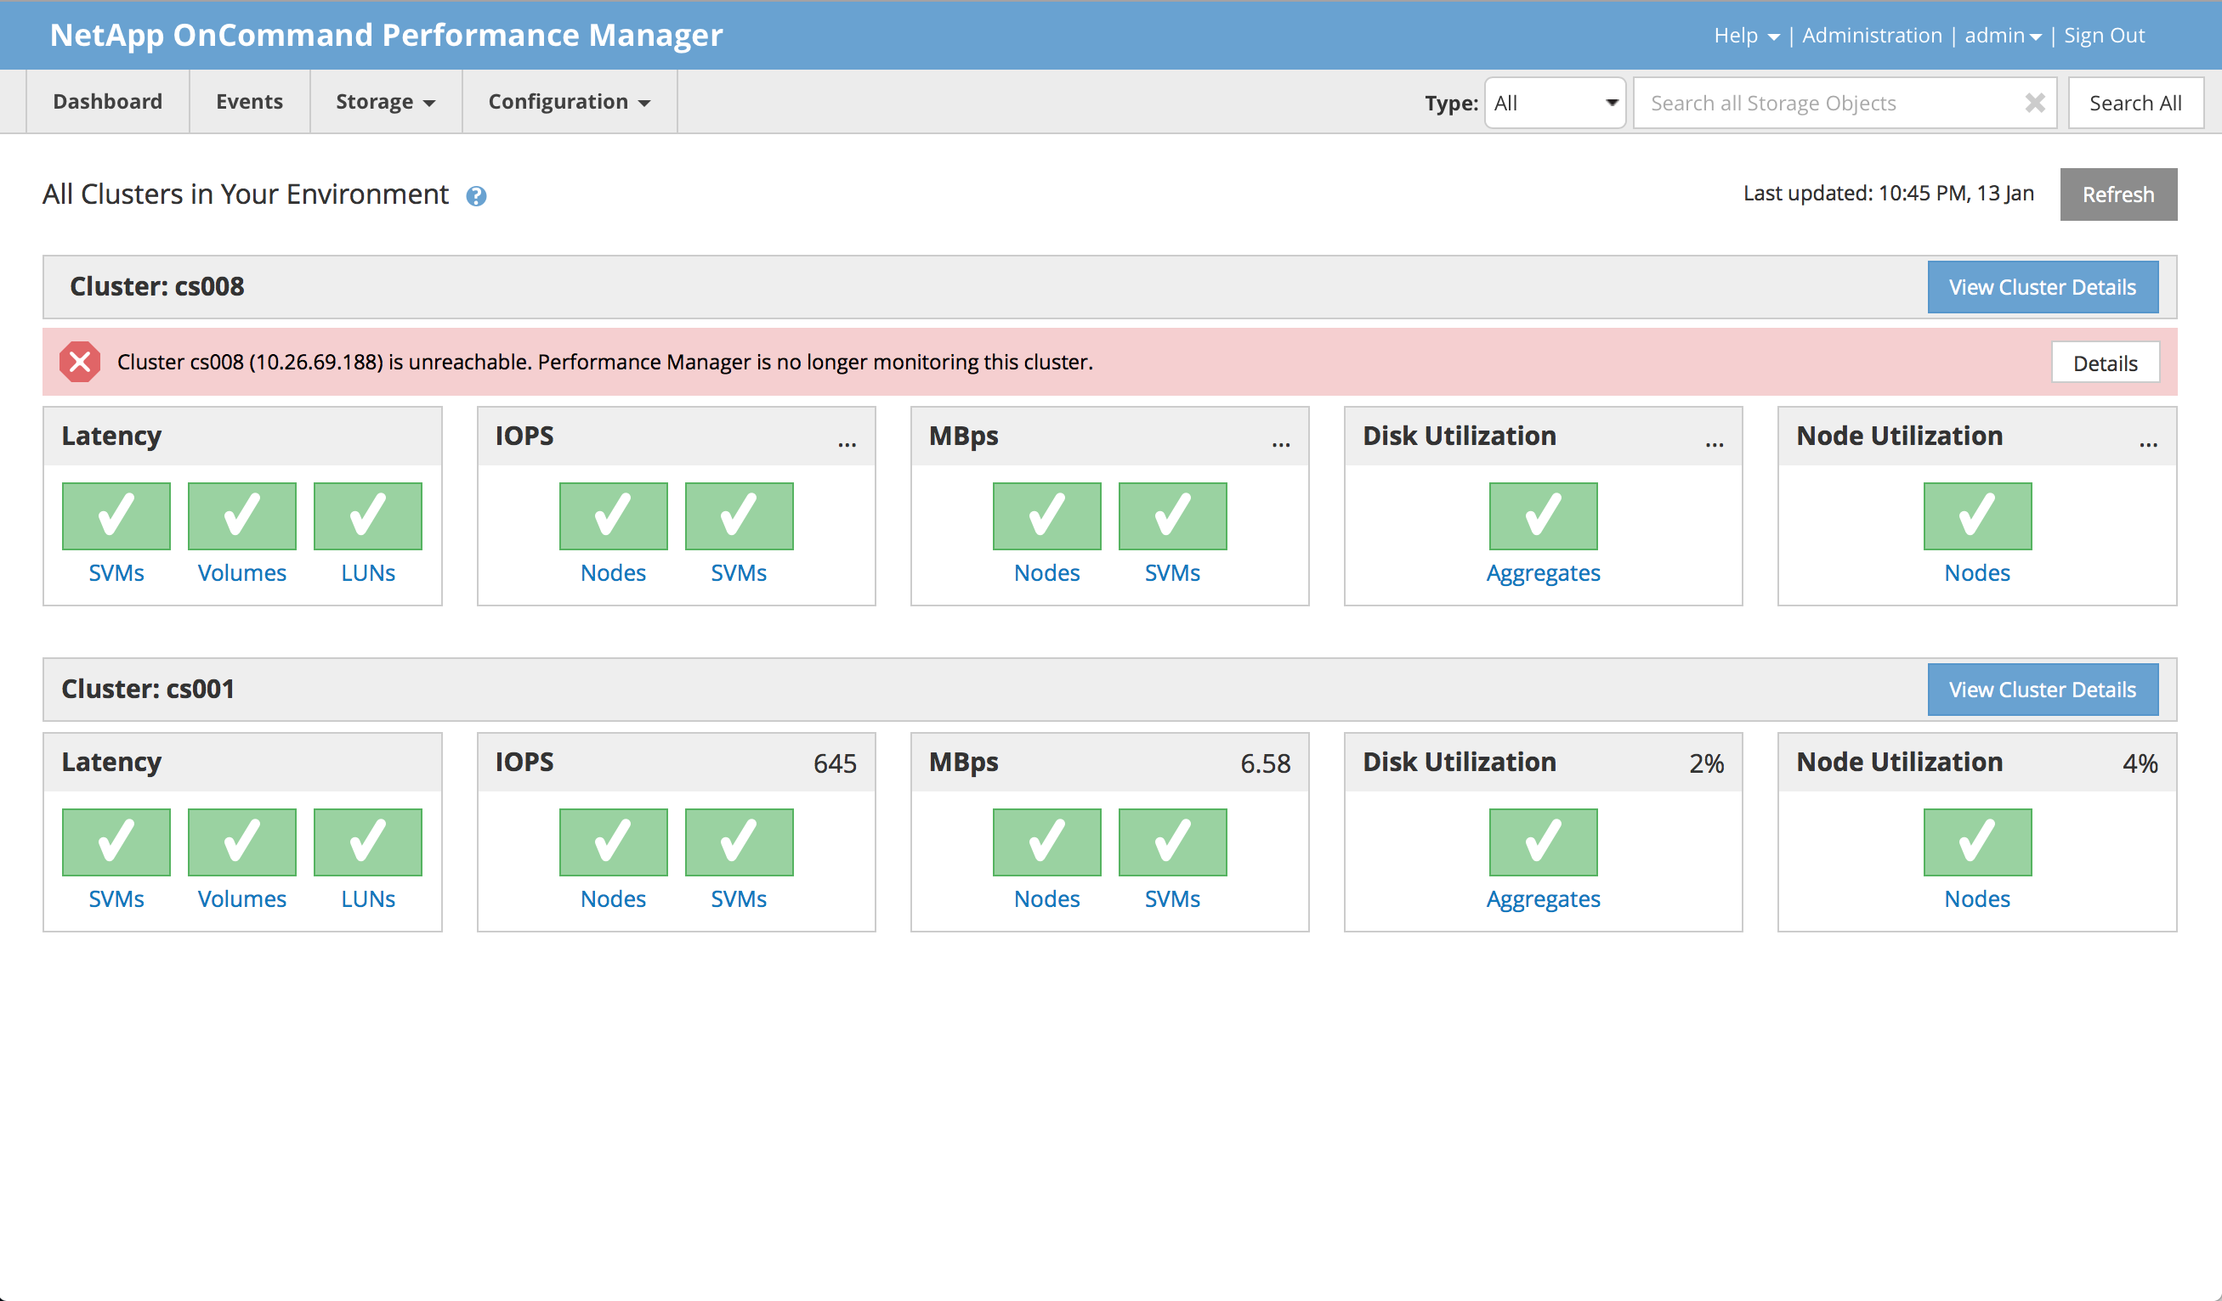
State of the Union: Performance Tools (Cont.)

Slide 5
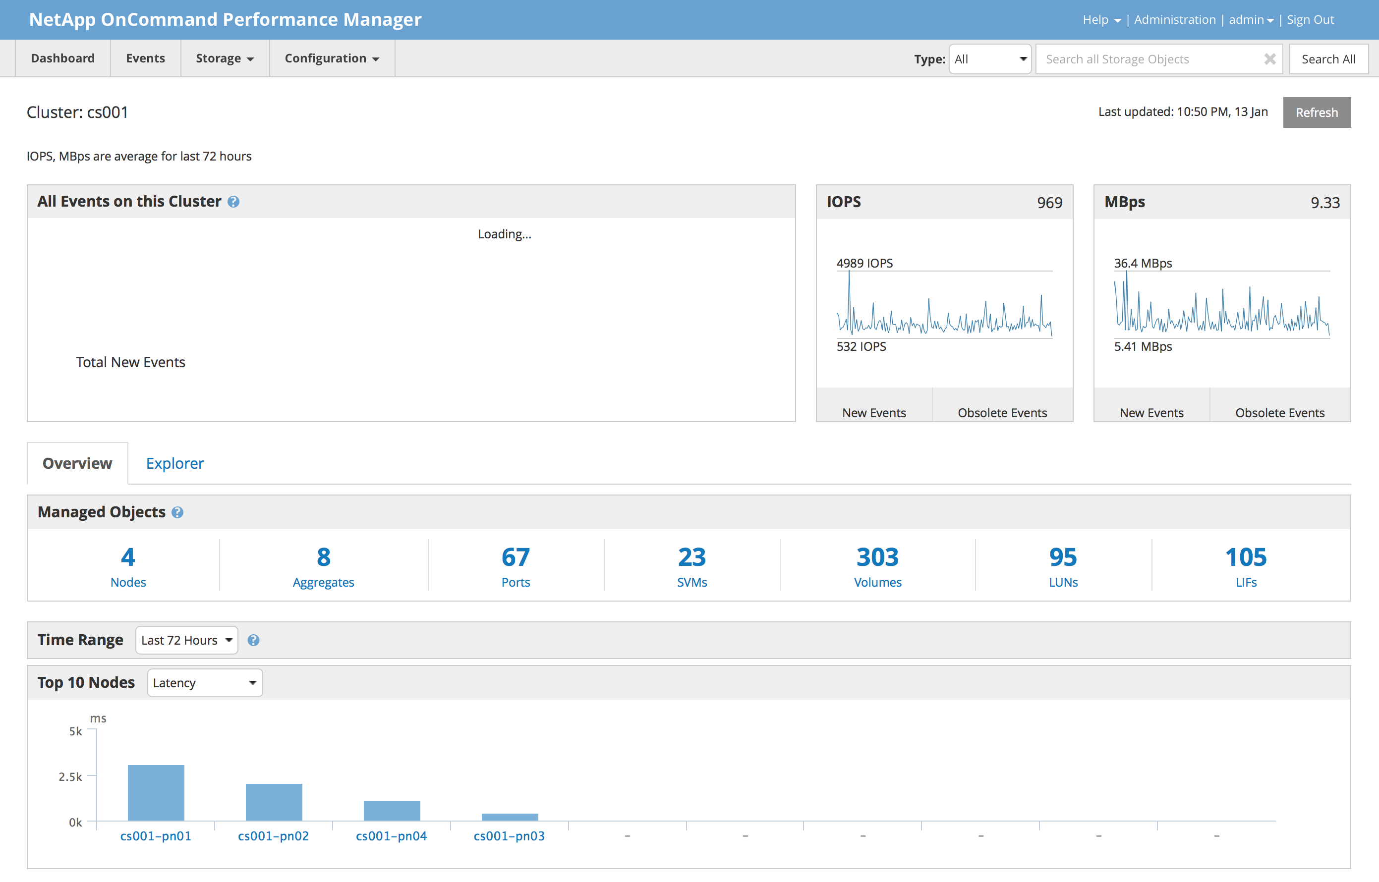
State of the Union: Performance Tools (Cont.)
Notes:
Make note about addition of custom thresholds along with improvements made to performance issue detection

Slide 6
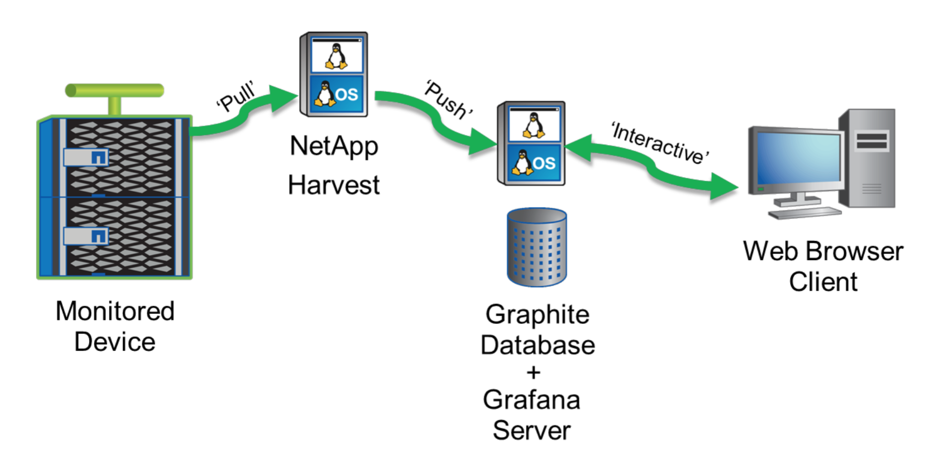
New Performance Monitoring Solution
NetApp Harvest
Perl-based application created by NetApp Enterprise Infrastructure Architect Christopher Madden
Collects data from 7mode/cDOT/OCUM 6.x systems on user-specified intervals
Relays data to time-series database (Graphite)
Data displayed using Grafana or another graphite-compatible dashboard solution
Notes:
Within the last calendar year a new performance monitoring solution exists which is known as NetApp Harvest.
NetApp Harvest is a Perl-based application written by a fellow NetApper that collects counter data from 7mode, cDOT, and OCUM systems and relays it to a time series database known as Graphite.

Slide 7
OPM 2.0 vs NetApp Harvest
 | OPM 2.0 | NetApp Harvest
Polling Interval | Every 5 minutes, hardcoded | 60 seconds, user configurable
Counter Inventory | 115 at most, 3 different presets | Flexible, roughly 500 counters, can be modified
Dashboards Provided | No | 19 Grafana dashboards, 500+ graph and singlestat panels
Support for 7mode | No | Yes
Storage Capacity Info | No | Yes through OCUM 6.x
Ease of Use | Deployable via OVA or RPM, configured through web interface | Deployed from zip file, configured via text file**
Supported By | NetApp Support | Community via communities.netapp.com
Licensing | Free | Free, Open Source
Source: Placeholder

Slide 8
Dashboard Examples

Slide 9
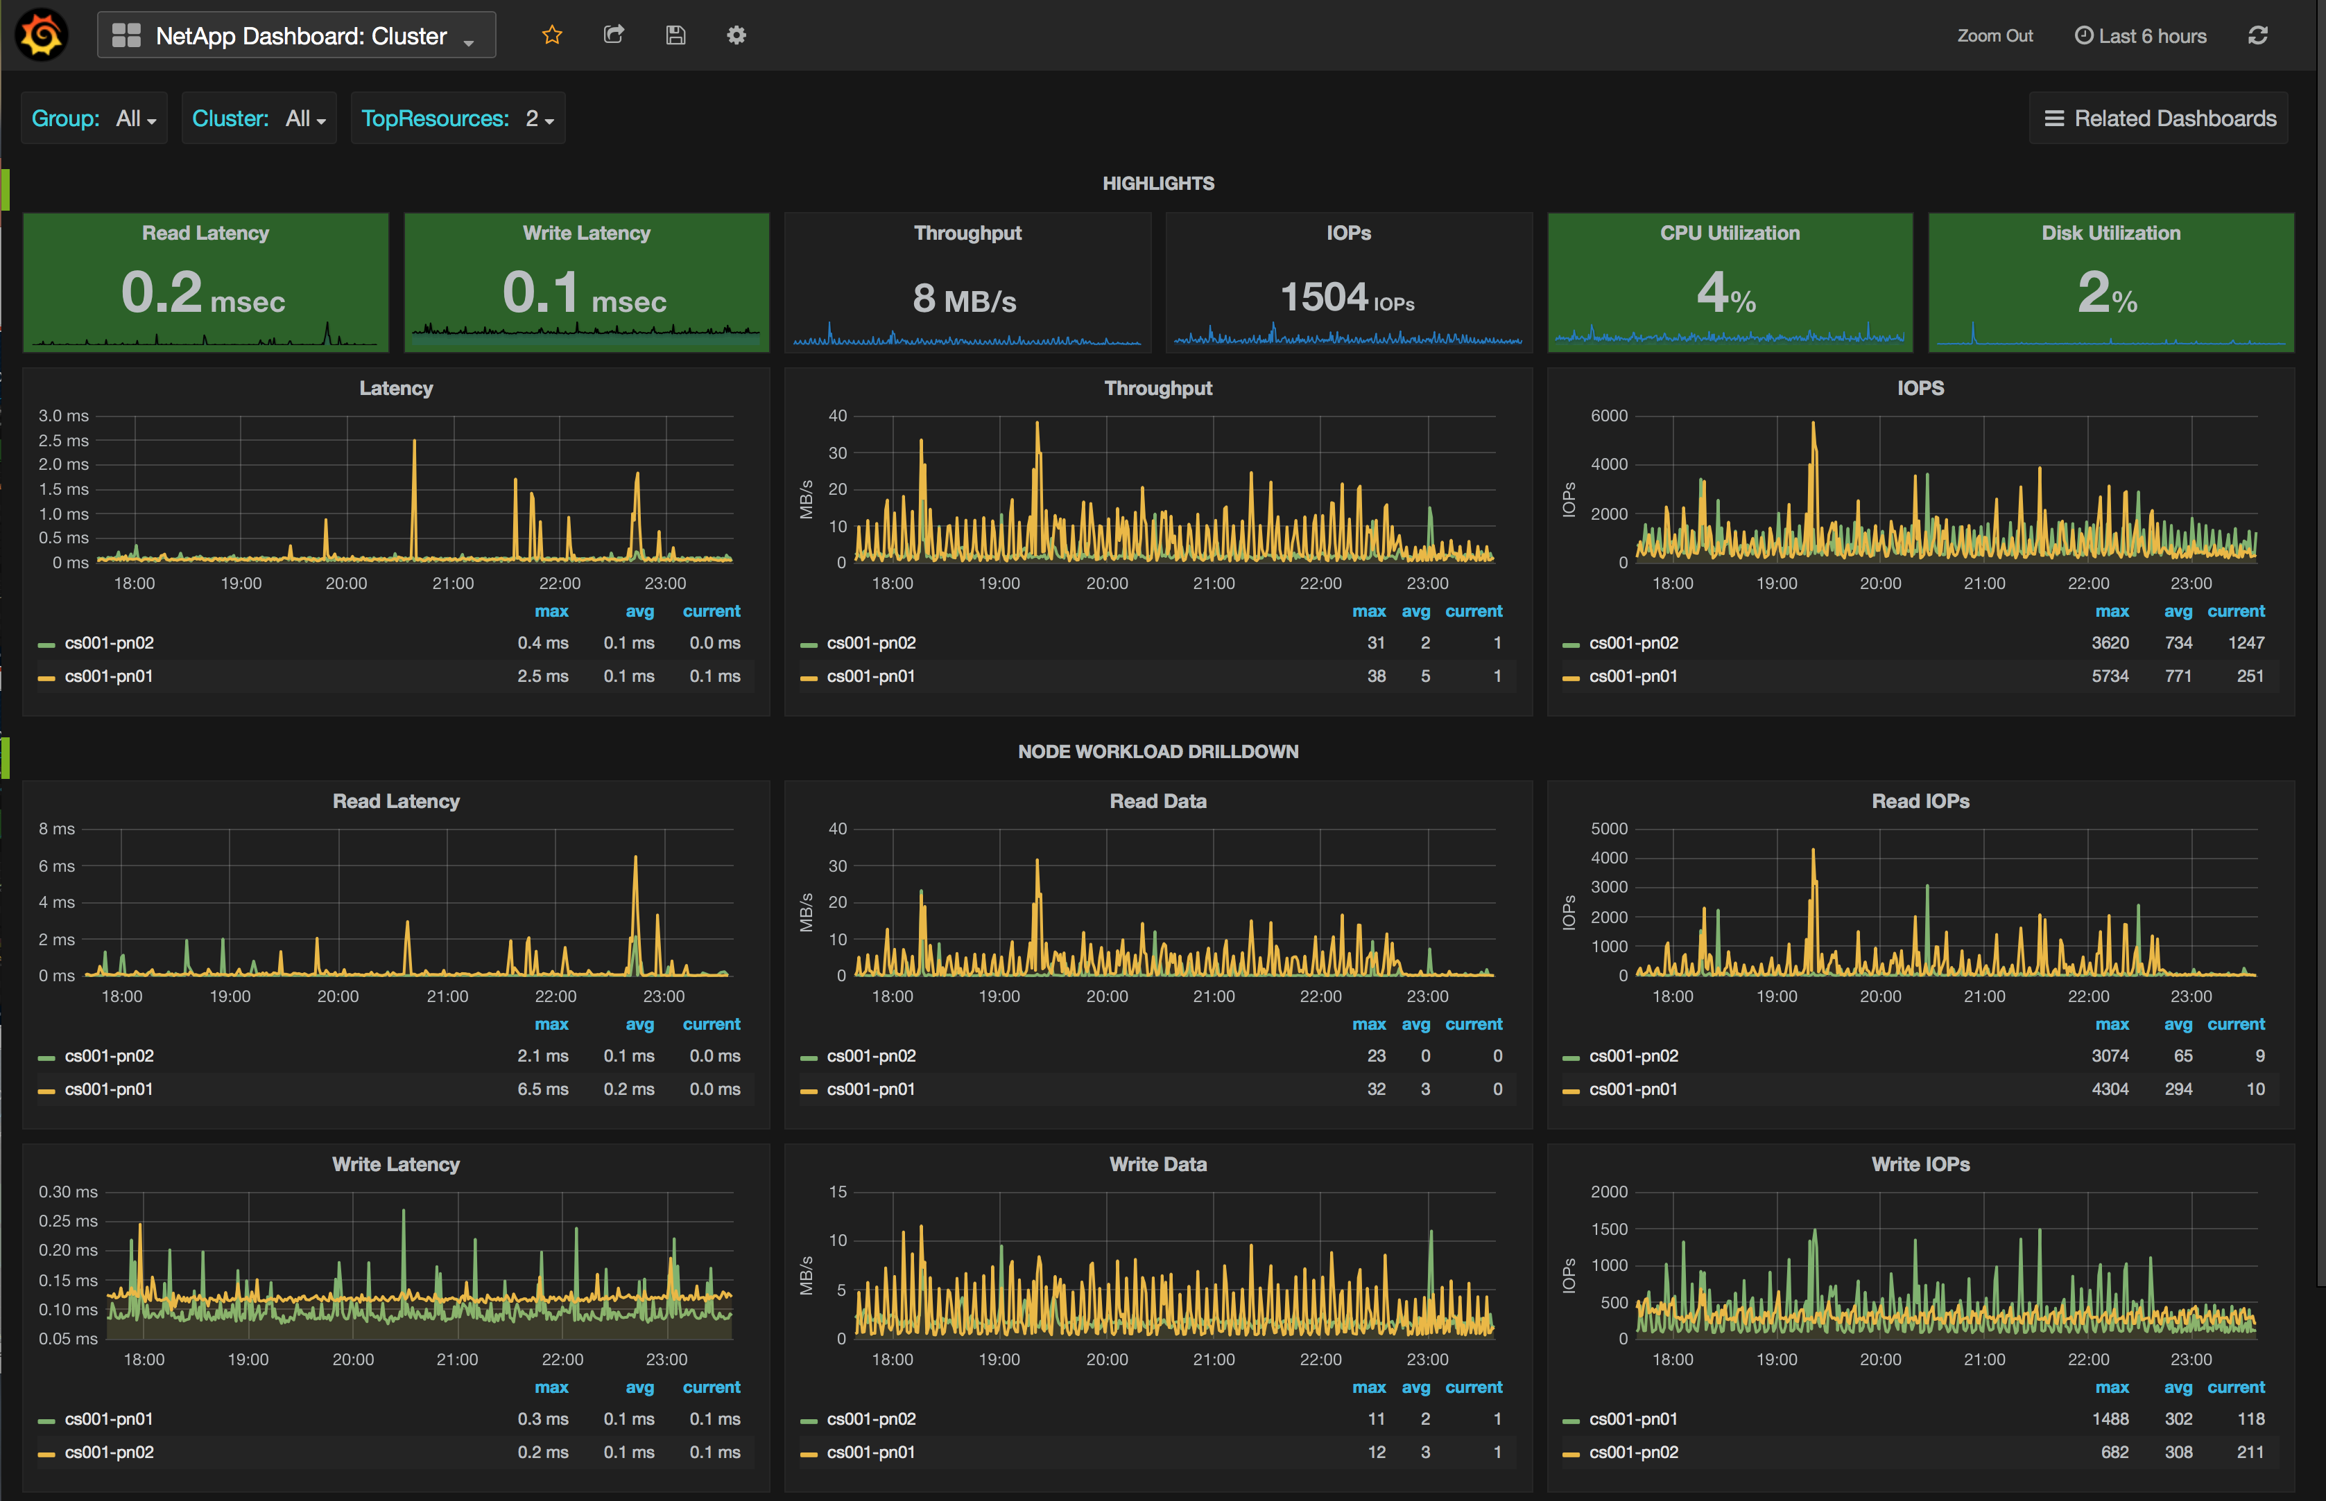
Dashboard Examples
Part 1 - Cluster Dashboard
Notes:
Explain typical layout of highlights section which is present in each dashboard in similar fashion
Explain how to filter based on group (site), cluster, topresources (top for each individual panel)
Explain how you can close and expand rows by going to the far left and clicking on the green button, then “Collapse row”
Explain how to fine tune time period and how it can be very granular & how you can keep the current filter by using the “related dashboards” button

Slide 10
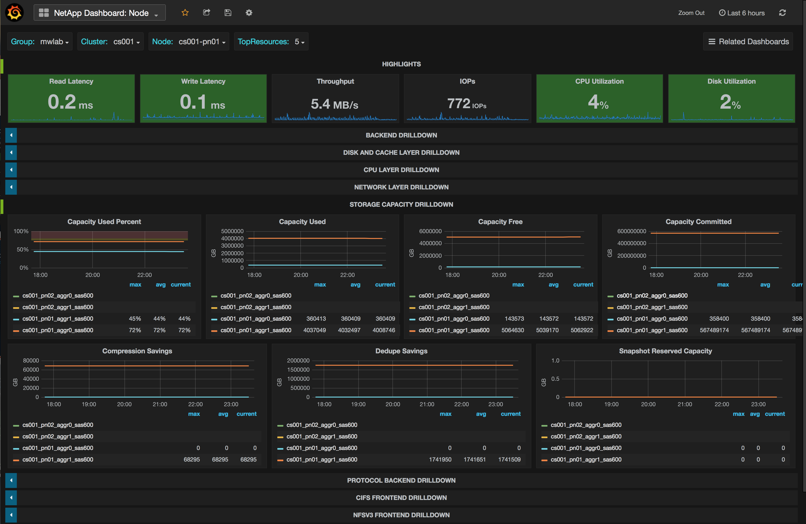
Dashboard Examples
Part 2 – Node Dashboard
Notes:
Another example showing some of the data displayed in the node dashboard

Slide 11
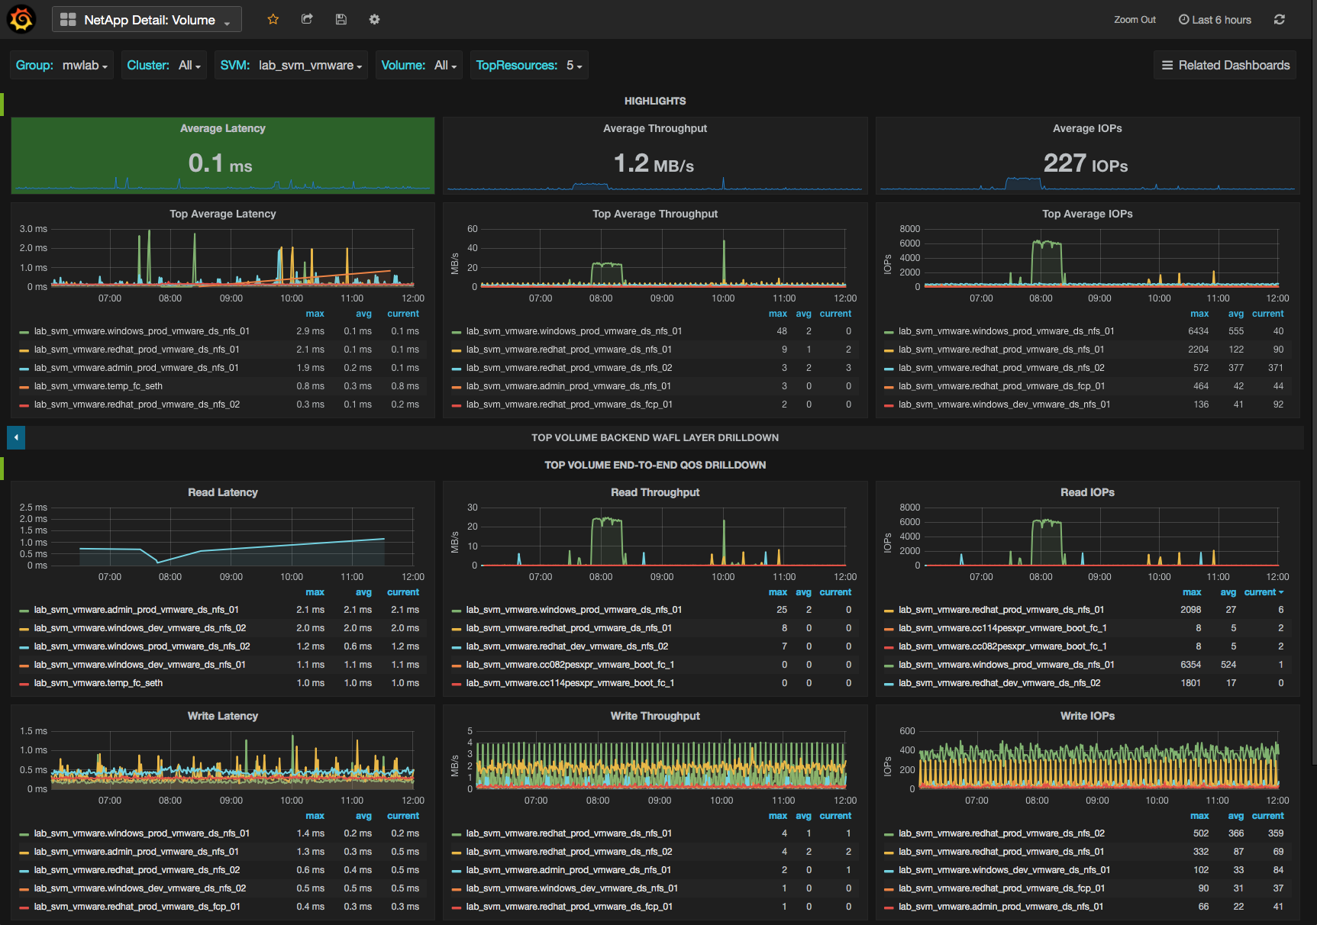
Dashboard Examples
Part 3 – Volume Dashboard
Notes:
Another example showing some of the data displayed in the volume dashboard, in this case showing performance data for the top 5 busiest volumes

Slide 12
Demo

Slide 13
Demo
Part 1 – Root Cause Analysis Example
At approximately 01:05 CST on 2016-01-14, users of ACME’s main web application reported “slow” page load times
What we know
Application server and database are stored in the “redhat_prod_vmware_ds_nfs_02” VMware volume
Aforementioned volume resides on the cs001-pn02 cluster node
Application’s database is sensitive to backend storage latency and requires sub-2ms response time
Goal
Use NetApp Harvest to determine root cause of latency spike
Notes:
Open Node Dashboard, set filter to January 14th 01:00 – 01:15
Set filter for one node (cs001-pn02)
Expand ”Backend Drilldown” row
Expand “Protocol Backend Drilldown” row
Compare throughput and IOPS values in both rows to prove the spike in activity is a result of user-generated activity vs background system activity (Such as dedupe, etc)
Open Volume Dashboard, set filter to January 14th 01:00 – 01:15
Discover top volumes, try and examine high activity volumes and verify they reside on the same node

Slide 14
Demo
Part 2 – Another Root Cause Analysis Example
At approximately 10:18 CST on 2016-01-14, ACME corporate users reported “slow” file transfers to many CIFS file shares
What we know
All volumes shared out via CIFS are attached to the “lab_svm_files” SVM
Each cDOT node has 1 active x 1Gb link to the upstream network at any given time
Only 1 x CIFS LIF exists for the aforementioned SVM, and it resides on the a0a (active/passive) ifgrp (1Gb) on the “cs001-pn01” cluster node
Goal
Use NetApp Harvest to determine root cause
Notes:
Open Node Dashboard, set filter to January 14th 10:15 – 10:30
Set filter for one node (cs001-pn01)
Make note of how node overall looks healthy based on highlights section.
Expand ”Backend Drilldown” row
Expand “Protocol Backend Drilldown” row
Compare throughput values in both rows to prove the spike in activity is a result of user-generated activity vs background system activity (Such as dedupe, etc)
Note higher than normal amount of CIFS traffic throughput
Open Network Port Dashboard, set filter to January 14th 10:15 – 10:30 (e0a – cs001-pn01)
Notice how network throughput for port matches the value from the previous dashboard
Now that we have confirmed this particular link is being saturated, let’s try to determine which volume(s) are generating this workload
Open SVM Dashboard, set filter to January 14th 10:15 – 10:30 (lab_svm_files)
Discover “top average throughput” volumes, and examine how throughput figures for “stuff_cifs_nfs_1” match data from previous dashboards confirming high read traffic is coming from this volume

Slide 15
Deployment

Slide 16
Basic Deployment Walkthrough
Part 1 – Prerequisites
Prereqs
Linux Server (physical or virtual)
CPU: 2 CPU
RAM: 4 GB
HDD: root (OS) file system – 20 GB+, /opt/data file system – 100GB+
Network: Outbound ftp/http/https access
Distribution: CentOS or RHEL is preferred
Access: direct or sudo-based root access to the aforementioned Linux system
Create Persistent Data Directories
Install & Start Docker
Build Docker Container
Final Steps

Slide 17
Basic Deployment Walkthrough
Part 2 – Create Persistent Data Directories
Prereqs
Linux Server (physical or virtual)
CPU: 2 CPU
RAM: 4 GB
HDD: root (OS) file system – 20 GB+, /opt/data file system – 100GB+
Network: Outbound ftp/http/https access
Distribution: CentOS or RHEL is preferred
Access: direct or sudo-based root access to the aforementioned Linux system
Create Persistent Data Directories
Install & Start Docker
Build Docker Container
Final Steps

Slide 18
Basic Deployment Walkthrough
Part 2 – Create Persistent Data Directories (Cont.)
Notes:
Create appropriate directory structure and set the correct ownership permissions
Make point that these steps can be directly copy/pasted from my blog under most circumstances

Slide 19
Basic Deployment Walkthrough
Part 3 – Install & Start Docker
Prereqs
Linux Server (physical or virtual)
CPU: 2 CPU
RAM: 4 GB
HDD: root (OS) file system – 20 GB+, /opt/data file system – 100GB+
Network: Outbound ftp/http/https access
Distribution: CentOS or RHEL is preferred
Access: direct or sudo-based root access to the aforementioned Linux system
Create Persistent Data Directories
Install & Start Docker
Build Docker Container
Final Steps

Slide 20
Basic Deployment Walkthrough
Part 3 – Install & Start Docker (Cont.)
CentOS/RHEL 6.7+
CentOS 7.0+
Red Hat Enterprise Linux (RHEL) 7.0
Other Distributions
See here

Slide 21
Basic Deployment Walkthrough
Part 4 – Build Docker Container
Prereqs
Linux Server (physical or virtual)
CPU: 2 CPU
RAM: 4 GB
HDD: root (OS) file system – 20 GB+, /opt/data file system – 100GB+
Network: Outbound ftp/http/https access
Distribution: CentOS or RHEL is preferred
Access: direct or sudo-based root access to the aforementioned Linux system
Create Persistent Data Directories
Install & Start Docker
Build Docker Container
Final Steps

Slide 22
Basic Deployment Walkthrough
Part 4 – Build Docker Container (Cont.)
Download the following files to “/root/docker/harvest” on the Docker host server
bashrc
Dockerfile
grafana_graphite_harvest_silent.sh
mysql_silent.sh
netapp_harvest_automated_setup
proxy_enable.sh
netapp-harvest-1.2.2.zip
netapp-manageability-sdk-5.4P1.zip
netapp-harvest-grafana-2.5.zip
Allow execution of recently downloaded scripts

Slide 23
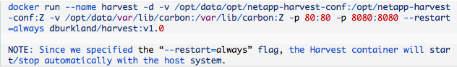
Basic Deployment Walkthrough
Part 4 – Build Docker Container (Cont.)
Build the Harvest Docker image
Deploy a new container using the new Docker image

Slide 24
Basic Deployment Walkthrough
Part 5 – Final Setup Steps
Prereqs
Linux Server (physical or virtual)
CPU: 2 CPU
RAM: 4 GB
HDD: root (OS) file system – 20 GB+, /opt/data file system – 100GB+
Network: Outbound ftp/http/https access
Distribution: CentOS or RHEL is preferred
Access: direct or sudo-based root access to the aforementioned Linux system
Create Persistent Data Directories
Install & Start Docker
Build Docker Container
Final Steps

Slide 25
Basic Deployment Walkthrough
Part 5 – Final Setup Steps (Cont.)
Create the Harvest user account & role on each NetApp system you wish to monitor
Define all applicable NetApp systems in Harvest configuration file “/opt/data/opt/netapp-harvest-conf/netapp-harvest.conf”
7mode controller or cDOT cluster
Login to the container and apply the final setup changes by restarting the Harvest service

Slide 26

Review
OPM is designed for detection and alerting on most common performance issues
For deeper investigation, use NetApp Harvest
19 dashboards with ability to customize
500+ counters
Built on open source technologies
Free: $0
Designed with scale in mind

Slide 27
Resources
[DBurkland.com] How To Setup NetApp Harvest Using Docker
Sources
[GitHub] dburkland/harvest Repository
NetApp Harvest Installation and Administration Guide
Christopher Madden’s Blog
2258-3: Real-time Monitoring of Clustered Data ONTAP
[DBurkland.com] How To Setup Graphite To Visualize OnCommand Performance Manager Data
[DBurkland.com] How To Setup Grafana with Graphite And Create Basic Dashboards
What is Docker?
Docker Volumes Using NetApp Storage
Myself
www.dburkland.com
Twitter: @dburkland

Slide 28
Thank you

